Slide 1

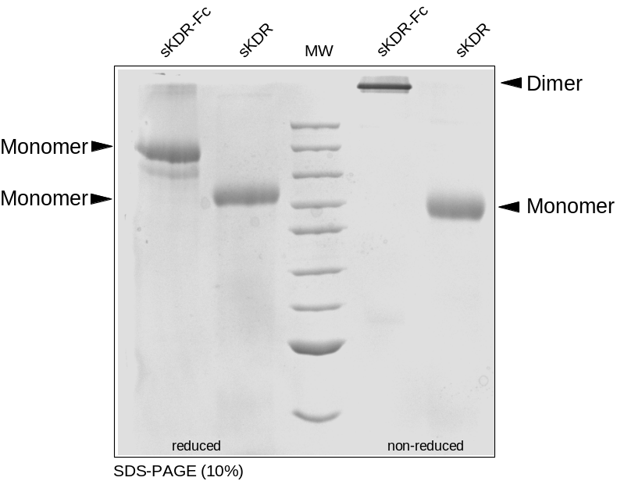
ReliaTech GmbH
Recombinant human soluble KDR (D7) and sKDR (D7)-Fc
(Cat #S01-001 / #SFC-007 )
Fig. 1: SDS-PAGE analysis of recombinant human soluble KDR (D7) and sKDR (D7)-Fc derived from insect cells. Samples were loaded in 10% SDS-polyacrylamide gel under reducing and non-reducing conditions and stained with Silver stain.
➔ Note: sKDR (D7)-Fc is able to form dimers whereas sKDR (D7) is not.
http://www.reliatech.de / orders@reliatech.de

